Slide 1
Bellabeat Case Study
How Can a Wellness Technology Company Play it Smart?
Presented by: Zachary Howser
Last Updated: August 3rd, 2022

Slide 2
Table of Contents:
Bellabeat Case Study
Purpose Statement
Data Sources, Cleaning, and Transforming
The Data Visualized

Slide 3
What is the Goal?

Slide 4
Objective:
Analyze Fitbit Fitness Tracker Data in order to gain insight into how consumers use their devices and transform these insights into actionable strategies for the Bellabeat marketing team.

Slide 5
Data Sources, Cleaning and Transforming

Slide 6
Data Sources
Is the Data ROCCC?
The data for this analysis is publicly available on Kaggle and stored throughout 18 csv files.
Reliable? - No, there are only 30 users’ data
Original? - No, it is provided by a third party (Amazon Mechanical Turk)
Comprehensive? - Somewhat, Parameters do match most of Bellabeat’s products
Current? - No, the data is 6 years old (March - May, 2016)
Cited? - No, the data is provided by a third party
Notes:
Limitations
30 female users are not a sufficiently large sample size.
Data collected is old (2016) so trends in activity and fitness may have changed
Data is collected via an optional survey so accuracy is not guaranteed
Data includes physical activity recorded, heart rate, daily activity, and steps

Slide 7
Data Cleaning and Transforming
Filter out any missing values
Convert the format of Activity Date to display the Day of the Week
Create a new column Total Minutes which is the sum of Very Active, Moderately Active, Fairly Active, Lightly Active, and Sedentary Minutes.
Create a new column Total Hours which is Total Minutes divided by 60 and rounded

Slide 8
The Data Visualized

Slide 9
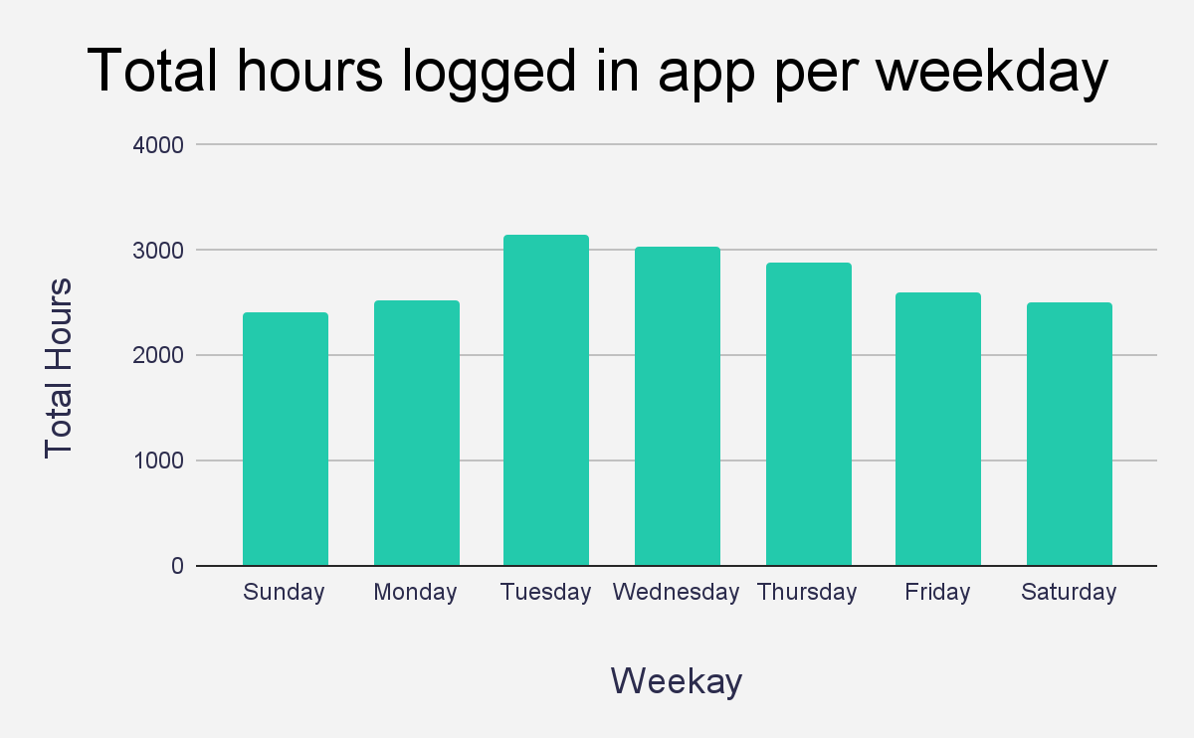
Daily Activity
Users prefer tracking data from Tuesday to Friday
Lowered frequency lasts from Friday to Monday

Slide 10
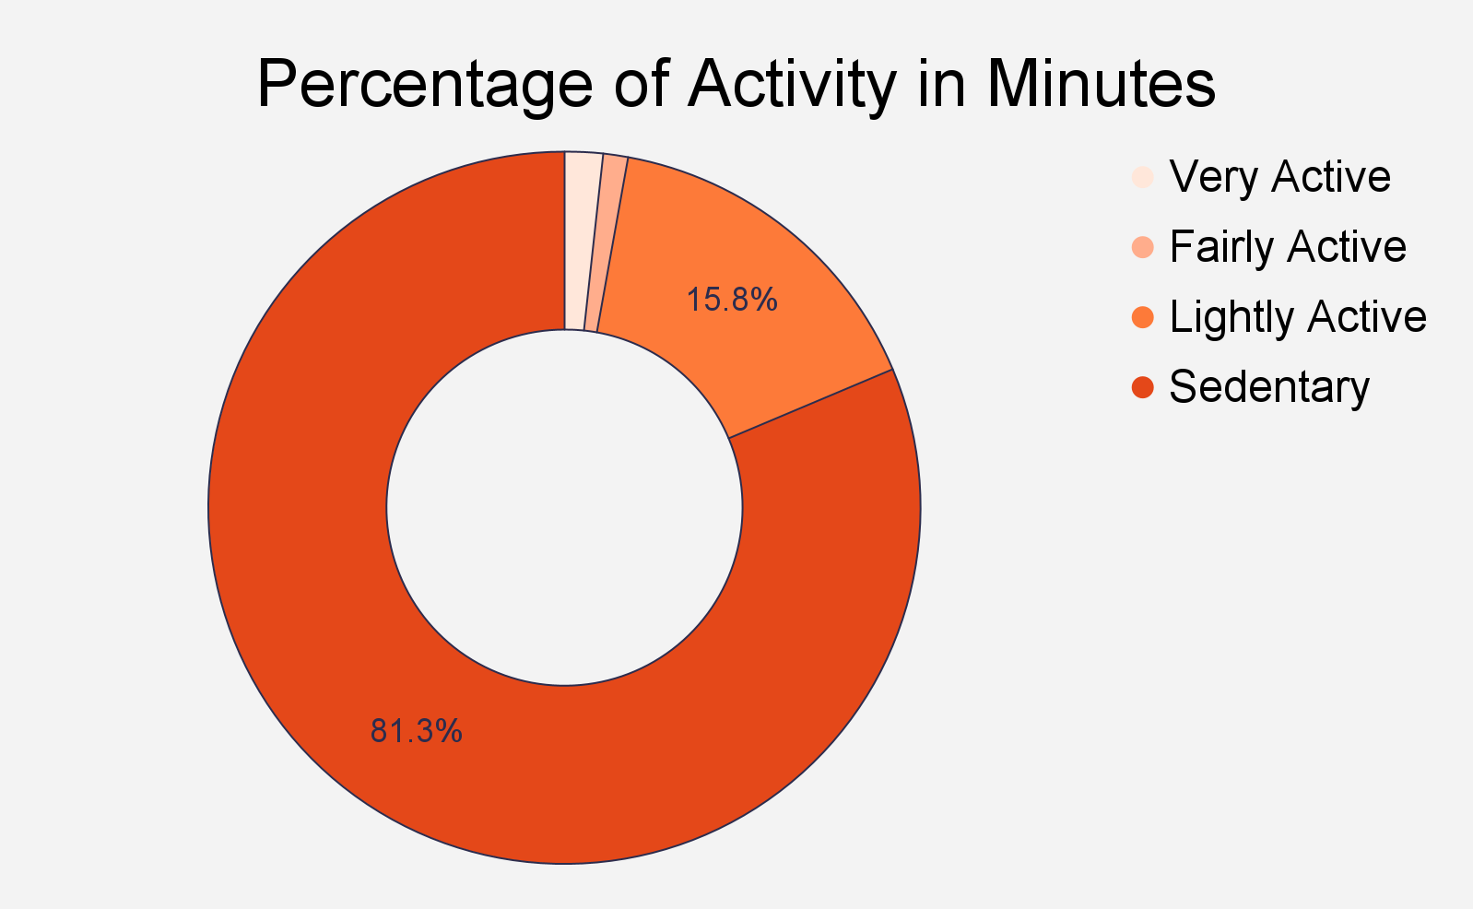
Activity Types
Sedentary minutes have the largest slice at 81.3%
Fairly and Very active minutes have the smallest at 1.1% and 1.8% respectively

Slide 11
Forming a Strategy

Slide 12
Applying the Trends to Marketing
The Bellabeat Marketing Team can encourage users to spend more time in the lightly to fairly active zones by educating users on the benefits of exercise and suggesting 10-20 minute workouts that would be fun and beneficial for users.
On Saturdays Bellabeat app can send notifications to encourage users to exercise over the weekend and recommend slightly more intense workouts to help users increase very active minutes.

Slide 13
Thank You!

